Slide 1
Business Intelligence
Report 2
Wyatt Freeman, Sophia Laraia, Ian Palacios
Spring 2021

Slide 2
Introductions
01
Chapter 4 - Predictive Analytics
02
04
Classification with WEKA
Regression with Excel
03
TABLE OF CONTENTS
05
Cluster Analysis with WEKA
06
Market Basket Analysis with WEKA
Quick summary of our group members
Data mining process, methods, and algorithms
Understanding k-fold cross-validation
Understanding the components of regression
Understanding k-means algorithm
Understanding relationships between association rules and market basket analysis.

Slide 3
01
Introductions

Slide 4
Introductions
Wyatt Freeman
Sophia Laraia
Ian Palacios
Information Systems, Business Analytics, & Entrepreneurship/Business Development.
Management Information Systems & FInance
Information Technology
Slides 6, 7, & 11
Template design, slides 13 & 15
Slides 8, 9, & 17

Slide 5
02
Chapter 4 - Predictive Analytics

Slide 6
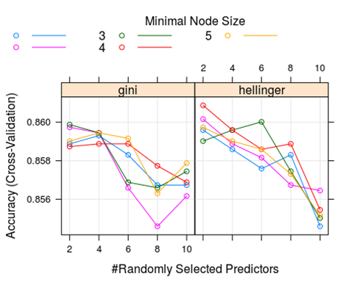
Random Forest Models
An advanced predictive analytics method is called the Random Forest method.This model creates hundreds of classification trees, going through thousands of iterations to merge the tree results together.
In Predictive Analytics class last semester, I built a Random Forest using the R programming language that predicted if bank customers were going to leave for another bank or not. The Random Forest generated 83% accuracy, much higher than the logistic model or single classification tree we also had to code for the project
The model determined Age, Number of bank services used, and Monthly activity to be the 3 most relevant variables.

Slide 7
Sensitivity and Specificity
The Random Forest model generated.9973 Sensitivity and .2062 Specificity. Sensitivity is defined as the proportion of positive results out of the number of samples which were actually positive.While sensitivity is the proportion of true positives that are correctly identified, Accuracy is the proportion of true results, either true positive or true negative.
When determining the causes of customer exit, it is better to use the Accuracy metric rather than the Sensitivity metric due to the nature of the issue. Every model produced very high Sensitivity but low Specificity. This means the models cannot detect false alarms very well and are prone to classifying False Positives. This issue can be solved by using the Accuracy metric when presenting to stakeholders.
My team recommended that the bank develop age-specific marketing campaigns to increase the number of products their customers use, simultaneously increasing Member Activity.

Slide 8
Method Differences & Use Cases
Method Differences:
Regression analysis
Find a relationship between independent and dependent variable
Classification analysis-
Assign items to categories
Cluster analysis
Find similarities in items and group them together
Association rule analysis
Find relationships between items
Method Use Cases:
Determine the amount of people passing a billboard to understand the maximum bid for it
Seeing different kinds of fruit and understanding which ones to keep together
Observing customers in a cafe and finding similarities between them from their orders.
Customers who bought generators and were members of the stores membership plan also bought extended warranties

Slide 9
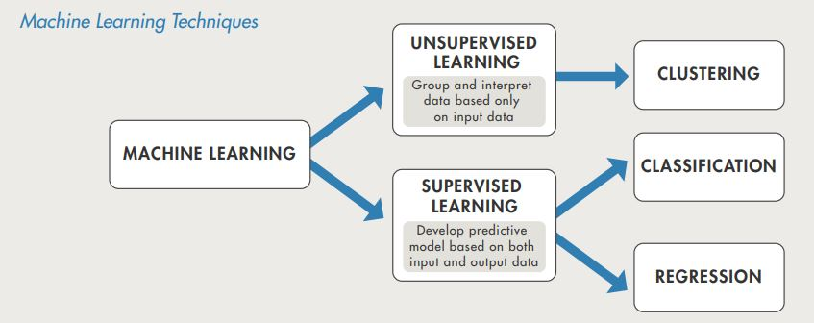
Data Mining Methods
Supervised Data Mining Method
Labeled training data
Input/Output
Learns from past
Unsupervised Data Mining Method
No previous data
Learns as it goes

Slide 10
03
Regression with Excel

Slide 11
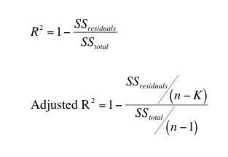
Regression with Excel
P-Value tells us the significance of individual variables. If the P-Value is below 0.05 it is considered a significant predictor in the model. Any variable with a P-Value above 0.05 ends up being pruned from the final model.
R-Square tells us how much of the model variance is accounted for. For example, if your Adjusted R-Square is .77, the model is missing 23% of the data needed to explain the Y variable results.
Adjusted R-Square calculates the same thing as R-Square but only uses significant variables to do so. A lower adjusted R-squared indicates that additional input variables are not adding value to the model.

Slide 12
04
Classification with WEKA

Slide 13
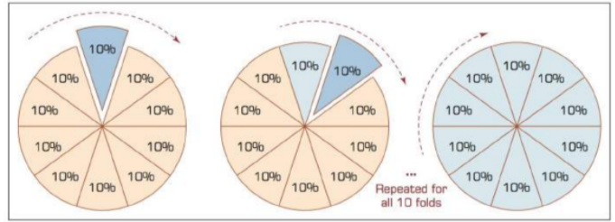
K-Fold Cross-Validation
K-fold cross-validation also called rotation estimation helps to minimize bias associated with the random sampling when comparing accuracy.
Works by randomly splitting the complete data set into ‘k’ subsets that are equal size. ‘K’ is the number of folds
The model trains and tests the amount of ‘k’. Each time, it trains all but one fold and test the remaining single fold
The cross-validation estimate of the overall accuracy is calculated by simply averaging the ‘k’ individual accuracy measures

Slide 14
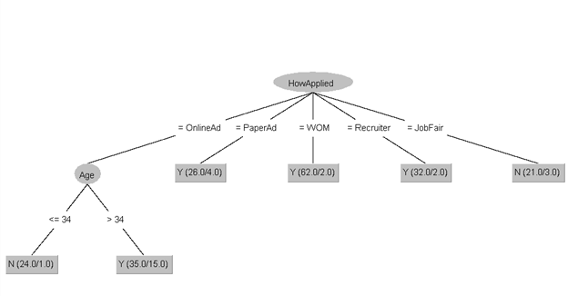

WEKA Classification: Employee Retention
Takeaway 1: People who applied through an online advertisement that are older than 34 will stay at the company for more than two years.
If employees were recruited from a paper advertisement, word of mouth or by an HR recruiter, then they are also likely to stay.
Takeaway 2: People who applied through a job fair in campus are most likely to quit within two year. Also,
If the employee were recruited from an online advertisement and is 34 years or younger, then they are likely to quit within two year.
Variables that predict who will stay for at least 2 yrs

Slide 15
05
Cluster Analysis with WEKA

Slide 16
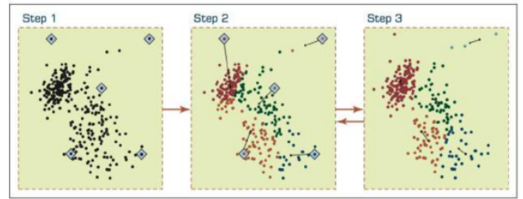
K-Means Algorithm
Summary: Splits data set into ‘k’ clusters each observation belongs to the cluster with the nearest mean
Initialization step: Choose the number of clusters
Step 1:Randomly create ‘k’ random points as initial cluster centers
Step 2: Assign each point to the nearest cluster center
Step 3: Recompute the new cluster centers

Slide 17
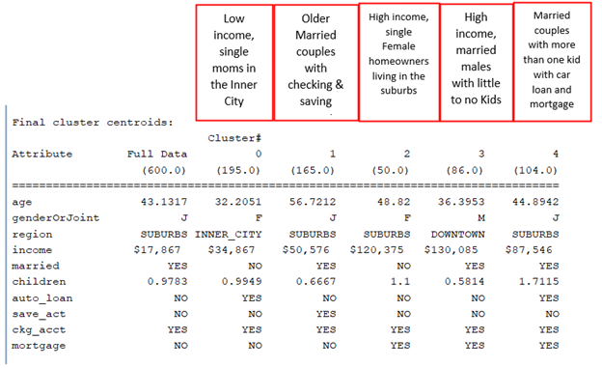
WEKA Cluster Analysis: Bank Customer Accounts
Point of diminishing return when ‘k’ = 5

Slide 18
06
Market Basket Analysis with WEKA

Slide 19
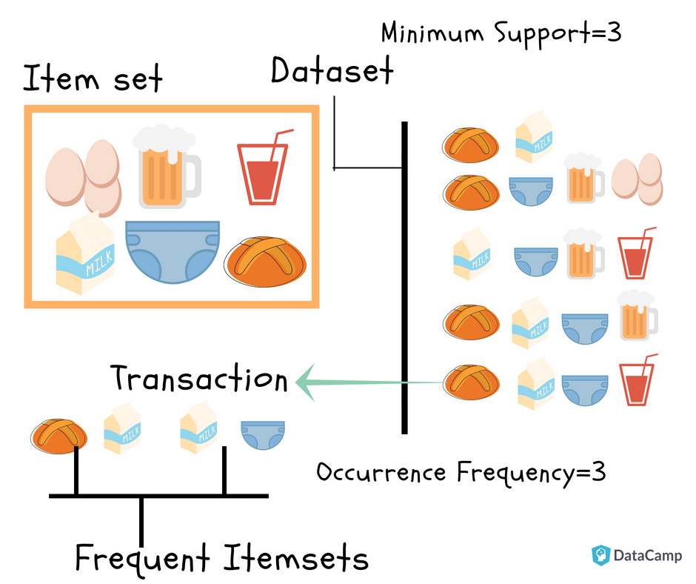
Market Basket Analysis
Association rule analysis is looking for relationships between items.
Market basket analysis is looking for relationships between items frequently together in transactions.

Slide 20
Questions?

